Slide 1

FAKULTI BAHASA DAN LINGUISTIK
GBT 0002 : CRITICAL THINKING AND PROBLEM SOLVING SKILLS
PN SITI ROHANA BINTI MOHD THANI
srohana@um.edu.my
603-7967 3116

Slide 2

WEEK 10
IDENTIFYING PERSUASIVE LANGUAGE (MEDIA)

Slide 3
Thinking Critically About Media
Week 10
Critical Thinking and Problem Solving Skills
By
Siti Rohana Binti Mohd Thani

Slide 4
The Goal
The goal of this chapter is quite simple: to keep you from simply becoming a zombie!
You shouldn’t be someone who simply passively absorbs and doesn’t think about or question anything that is thrown at them by the media.
We will examine ‘the news’ and ‘advertisement’

Slide 5
The Mass Media
Mass media has its name, not because of the size of the media organizations themselves (like ABC,NBC or CBS), but of the massive audience they reach.
- It also includes music and movies, magazines, newspapers,
posters, flyers, comic books, novels, textbooks, etc
Some publications are audience specific, catering to intelligence level (Washington Post), political affiliation (National Review) or other criteria.
- They usually favour one side of the story.
Others (CNN, Time, Newsweek) cater to the broader audience of nearly everyone.
We will begin by focussing on the NEWS MEDIA

Slide 6
The Importance of Context
Limited by time and in an effort to hold our attention (and thus keep us viewing) news organizations often present us information that is far out of context and thus mostly useless.
-eg: the sound bite phenomena, misrepresentations of scientific
studies, etc
Although maybe good for getting the basics, the news usually does not provide the in-depth information necessary to fully understand a topic, issue or current event.
If one wants or needs to know, a deeper look and research will always be required.

Slide 7
Getting us to Pay Attention: What Really Drives the Media
Some may think that the news media is driven by the need to inform and doesn’t care about keeping viewership and thus not about getting people to ‘pay attention’ or ‘tune in.’
But, except for the rare exception of public broadcasts (like PBS) and the like, media is fuelled by advertising. The money advertisers spend on ad time/space is used to produce the media. The more people watch/read/listen, the more the ‘ad time’ is worth, and the more that media outlet can charge.
Since they know that people won’t listen to real in-depth analysis—most people will just tune that out ---they give you what ‘sound good’ and will keep you interested.
This is also why your local news reportersalways seento prey on your fears. (‘Your children might die tomorrow! More at 11!’).If you think your children’s lives depend on watching, you are more likely to watch.

Slide 8
Keeping our Interest: The News as Entertainment
The more entertaining something is, the more likely we are to ‘tune in.’ Being entertaining is fine, but only if doing so doesn’t sacrifice ‘integrity.’
How the media entertains us: by giving us dumbed down information that is ‘fun to eat but ultimately unhealthy.’
- Selecting events and details, because of space and time constraints,
can lead to ‘slanted’ news because the person selecting either chooses
what is important to them or simply what people will find most
enjoyable.
- What makes the news: usually what is most attention getting – not
what is actually important.
- What doesn’t make the news: complicated stories, things critical of
powerful organizations or the media itself.
- Arranging and organizing stories: by headlining or emphasizing a
story, the media can make us think soothing is more important that it is.

Slide 9
Keeping our Interest: The News as Entertainment
Slanting the news: most journalists try to avoid ‘slanting,’ but pure objectivity is almost impossible.
Attempts at objectivity –- just reporting exactly what you hear --- often lead to the reporting of unsubstantiated claims (which is just spreading rumour).
Perceived bias? Although most journalists are liberal, there is not much of a case for ‘media bias’
- It would not be profitable; it would alienate the public which is ’in the middle.’
- Most people see the media as biased ‘on the other side.’ If one is liberal, one thinks the
media has a conservative bias, and vice versa. This is obviously due to our own bias
(we remember and get upset at what we don’t like), not what is actually there.
Opinion in the media: The expression of opinion in all forms of media has become increasingly common (the O’Reilly Factor, blogs). But most of it is uninformed, We must be critically evaluate the claims of others and their arguments (if they bother to give any)

Slide 10
Media Literacy
It must be remembered that the media also does many good things and our lives would be worse without it.
But the line between news, entertainment, and advertising has become blurred. News tries to entertain, entertainment passes as news, and ads disguise themselves as news (e.g., infomercials).
One needs to be “media literate”, be able to effectively and efficiently comprehend and utilize mass communication.
See list of critical questions to ask on page 453.

Slide 11
Advertising
Ads are everywhere and have two basic functions: to inform and motivate (usually to buy a product).
What ads do:
Morally good ads are truthful, informative and persuasive.
Some just rely on product recognition (e.g., Nike’s “Just do it”).
But many lie and distort.
They also shape the values of our culture, making people value wealth, status, popularity and prestige over quality of life, being “true to yourself” and thinking for yourself.

Slide 12
Advertising
Defenses of Advertising:
It informs the public.
It drives competition and development.
It makes large scale consumption possible, which reduces prices.
It allows for “government free” media outlets.
Criticisms of Advertising:
It is intrusive.
It corrupts (by instilling immoral values).
It takes advantage of kids (Kid’s Cereal).
It is deceptive.
Low involvement buying: Ads are most effective for cheap items. Since most everything that costs little is pretty much the same, and you are likely not to put much thought into the purchases anyway, you are more likely to buy something you have heard about repeatedly.

Slide 13
Common Advertising Ploys
… that advertisers use as short cuts around “informed decision”
Humor: If we laugh we remember, and if we remember we buy.
Catchy Slogans and Jingles: If it sticks in your head, it is likely to repeat itself in your head when you are making your buying decision.
Anxiety Ads: create “needs” by creating fears of “not measuring up” and offer a way to alleviate the fear.
Emotive Language: attaching “positive” words (pleasure, fresh, clean) to your product to elicit a positive opinion about the product (e.g., “fancy ketchup”).
Weasel Words: words that give false appearances (e.g., “may help”, “as low as”, and “up to”).
Fine-print Disclaimers: the “bad stuff” at the bottom that tells you everything in big print is a lie.

Slide 14
Common Advertising Ploys
Puffery: exaggerated claim that skirts the literal truth but does so in a way that does not deceive most audiences. “We have the lowest prices”. Most people know not to believe them, and they know that – so are they lying ?
Sex Appeals: Products associated with sex are easier to remember. Good looking models seem to make a product seem better. And it works. Sex really does sell.
Feel-good Ads: Again, positive associations make the product seem better.
Image Ads: Appeal to desires to have a certain image, often “most expensive” is portrayed as “the best”.
Celebrity Endorsements: For some reason, seeing a celebrity behind a product makes people want the product – even if people know they are only there because they were paid to be.

Slide 15
Persuasive Language
Critical Thinking

Slide 16
Persuasive Language
Language is used to persuade or convince others to act or think in a certain way
Found in politics as ‘propaganda’
Also found in the language of advertising
Many techniques that aim to influence others’ thinking:
- Language
- Fallacies
- Statistics
- Appearance
- Offers
- Testimonials

Slide 17
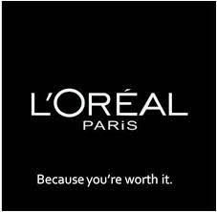
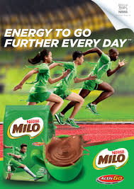
Language : Memorable slogans
A Memorable phrase is used in a campaign or a series of commercials. Viewers remember the slogan and associate it with the product.
Eg:

Slide 18
Language : Vagueness / ambiguity
Words that lack a clear and distinct meaning
Eg.:
‘She is really smart’ --- General
‘She got an A in physics’ ---specific
Sometimes euphemisms are used
One strategy for clarifying vague language is to ask and try answer the following questions:
Who? What? Why? Where? How?

Slide 19
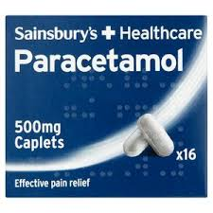
Language : Scientific
Words that have a scientific basis
These words are usually created / used to give an impression of important scientific methods of research or medical / scientific breakthroughs
Eg.:
Paracetammol is effective to relief pain
Patented oligo-peptide (Pal-KTTKS) serum is the leading anti-agingcream in the industry
Ultra-concentrated skin care cream features 5-percent striadril complex Topical cream by Klein-Becker USA

Slide 20
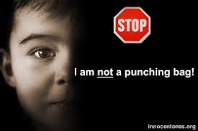
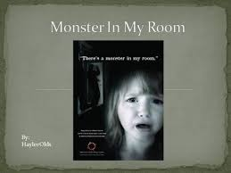
Language : Emotive
Emotive language uses strong adjectives to raise emotions such as sympathy / anger towards a certain cause.
Advertisements that often use this technique to gain our attention are charity ads, ads --- against smoking, child abuse etc
Eg,:

Slide 21
Fallacies
Several types of fallacies used:
Appeal to vanity
Appeal to fear / security
Bandwagonism

Slide 22

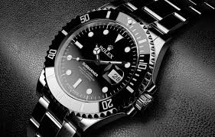
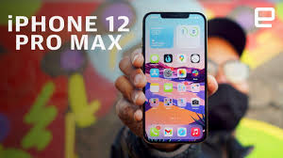
Appeal to vanity
Make you feel special
Arouses the desire to achieve status or wealth or to feel superior (snob appeal)

Slide 23
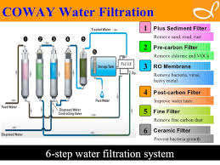

Appeal to fear / security
Draws on people’s fears that their belongings, families, or lives may be in danger if they don’t buy the product.

Slide 24
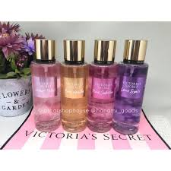

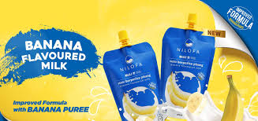
Bandwagonism
Tells people that everyone uses the product
Viewers buy the product to fit in or because
they assue if others use it, it must be good.
Eg” ‘Find out why so many people buy this product!’

Slide 25
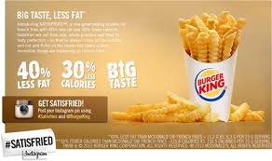
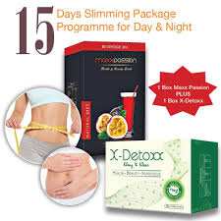
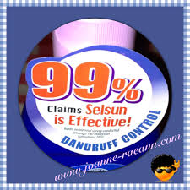
Statistics
Use of statistics to persuade people that there are studies to show many people find the product effective
Usually statistics are vague or general, and do not give accurate or specific sources
Eg:

Slide 26
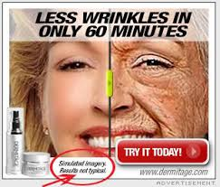
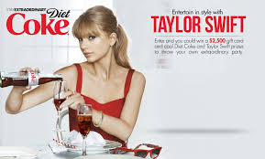
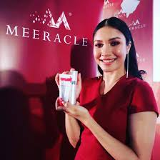
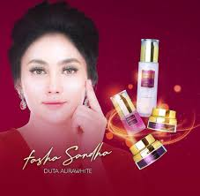
Testimonials
‘Real’ customers’ review
Celebrity endorsements

Slide 27
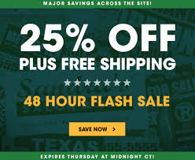


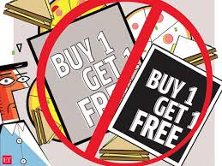
Other techniques
Promotional offers
Eg: Buy one, get one free!
Awards won

Slide 28
Other techniques:
Visuals --- pictures, photos, images
Colours
Font
Headings – bold, highlights

Slide 29
Advertising
To inform
To motivate
2 basic functions

Slide 30
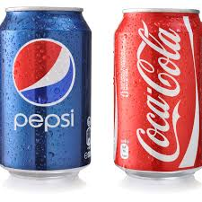
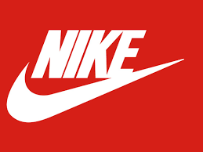
Advertising
Some advertisements seek to motivate without providing any information at all.
Sells on the basis on brand recognition alone

Slide 31
Advertising Techniques
1. Humour
2. Catchy Slogan and Jingles
Effective in grabbing our attention
Repeated slogans and jingles over time can produce major perceived differences between brands
Eg ‘There are some things money can’t buy. For everything else, there’s MasterCard.’

Slide 32
Advertising Techniques
3. Anxiety Ads
4. Emotive Language
Play on our fears, anxieties, and insecurities
Eg. Dandruff, bad breath, losing hair, body weight, etc
Use of correct words can instill an enticing mood and attitude
Eg” pleasure, fresh, clean, natural

Slide 33
Advertising Techniques
5. Weasel Words
6. Fine-Print Disclaimers
Used to water down or qualify a claim to that it ends up being practically meaningless.
Eg: helps, may, can be, fights, as low as, as much as, up to, etc
Often found in ads with fantastic offers and prizes.
e;g: ‘Sale 50% off’

Slide 34
Advertising Techniques
7. Puffery
8. Sex Appeals
Exaggerated claims that skirt the literal truth but does so in a way that does not deceive most audiences.
Eg: ‘nobody sells for less’, ‘everyone is talking about it’, ‘the best Mexican food in town’, etc
Sex sells and advertisers use it to appeal to the consumers.
Eg: use sexy girls to promote latest gadgets, cars, clothing, etc.

Slide 35
Advertising Techniques
9. Feel-Good Ads
10. Image Ads
Creates positive emotional associations by linking the good feelings elicited by the ad with the brand.
Eg: traffic-free street where a man is driving a sporty car with a beautiful lady by his side and loud music blaring in the background.
Used to appeal to certain images people have of themselves --- competent, cool, rugged, responsible, sophisticated.
Eg: Piaget watches have ‘exceptional character’, Saks Fifth Avenue’s clothes are ‘defining style’

Slide 36
Advertising Techniques
11. Celebrity Endorsements
We tend to identify with people we envy and admire for their celebrity status.
Eg: perfumes, cars, clothes, watches, shampoo, etc

Slide 37
Any Questions
Thank you

